Slide 1

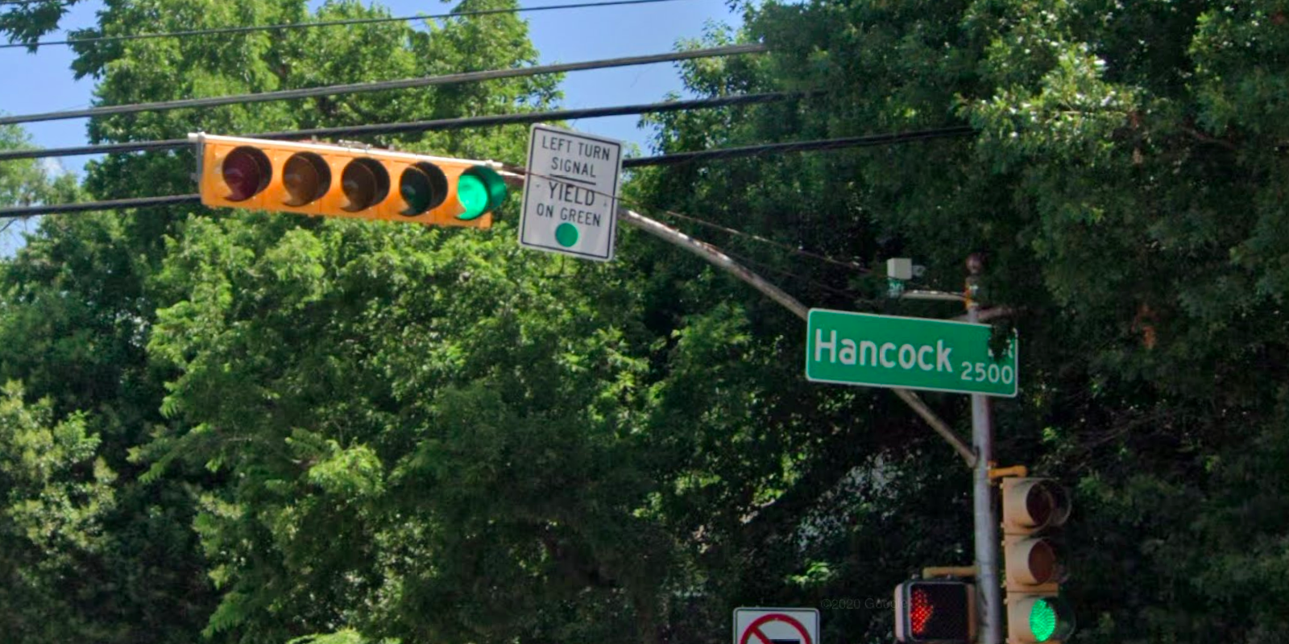
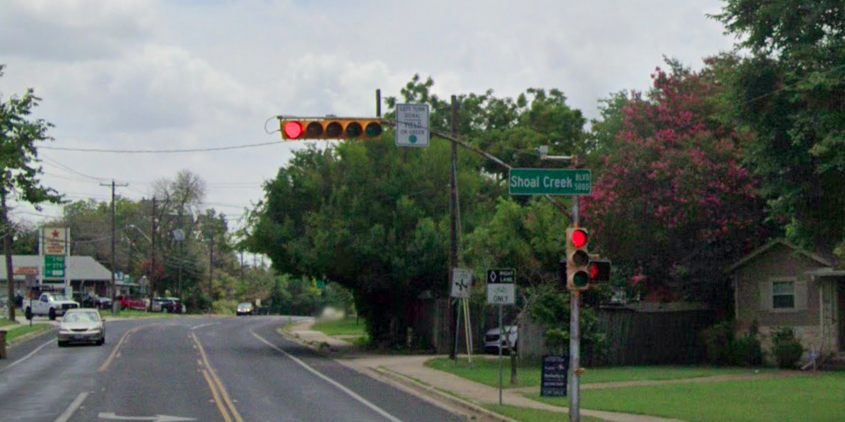
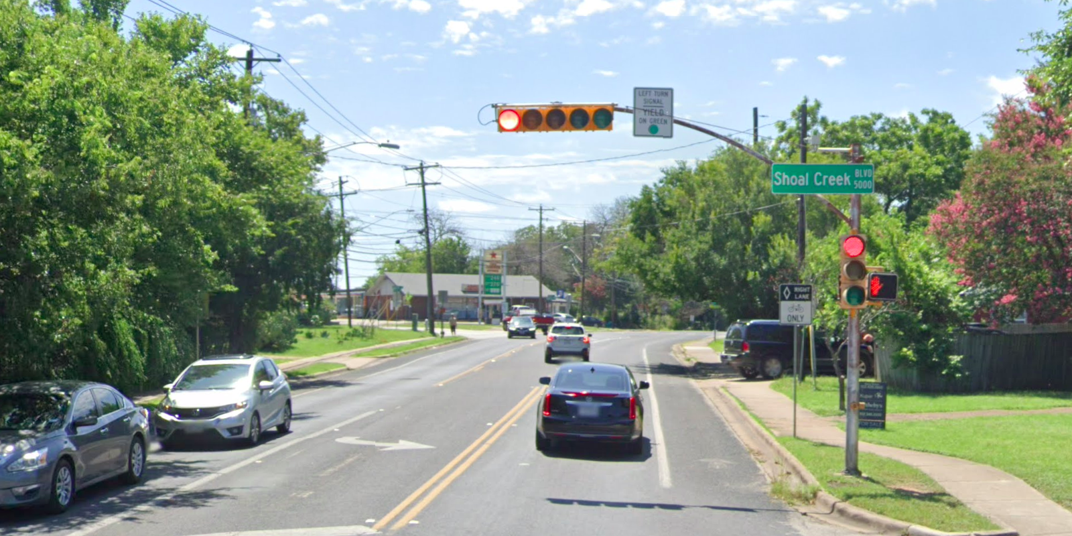
Austin Transportation Department Signs Work Orders
Austin Transportation Department Signs Work Orders
Austin Transportation Department Signs Work Orders
Austin Transportation Department Signs Work Orders
Location Name: SHOAL CREEK BLVD / HANCOCK DR Intersection ID:5156414Cardinal Direction: N
Location Name: SHOAL CREEK BLVD / HANCOCK DR Intersection ID:5156414Cardinal Direction: S
Location Name: SHOAL CREEK BLVD / HANCOCK DR Intersection ID:5156414Cardinal Direction: E
Location Name: SHOAL CREEK BLVD / HANCOCK DR Intersection ID:5156414Cardinal Direction: W

